Slide 1
CS 355/555
Probability and Statistics for CS
Baocheng Geng
Lecture 16, 02/26/2025
CS 355/555 Probability and Statistics for CS

Slide 2




Introduction
Multiple Random Variables
Introduction
Multiple Random Variables
3
Examples
4
Next Time
CS 355/555 Probability and Statistics for CS

Slide 3
Copyright Statement
Copyright Statement
Materials prepared for and/or included in this course are protected by copyright law. They are intended to be used only by students enrolled in this course during the current term and should not be further disseminated without prior permission from the course instructor.
CS 355/555 Probability and Statistics for CS

Slide 4
Example 2.11
n people throw their hat in the air. Each one then picks up a hat. What is the expected number of people who get back their own hat?
CS 355/555 Probability and Statistics for CS
15/27 10:50

Slide 5
Example 2.11
Suppose n = 2, a and b.
Two possibilities:
a | b
a | b | 2 | .5 | 1
b | a | 0 | .5 | 0
 |  |  |  | 1
CS 355/555 Probability and Statistics for CS

Slide 6
Example 2.11
Suppose n = 3, a, b, c Six possibilities:
a | b | c
a | b | c | 3 | 1 6 | .50
a | c | b | 1 | 1 6 | .17
b | a | c | 1 | 1 6 | .17
b | c | a | 0 | 1 6 | .00
c | b | a | 1 | 1 6 | .17
c | a | b | 0 | 1 6 | .00
 |  |  |  |  | 1
Really should be ¹ instead of .17
6
CS 355/555 Probability and Statistics for CS

Slide 7
Example 2.11
Suppose n = 4, a, b, c, d.
24 possibilities:
Add hats in every possibility and get 24.
CS 355/555 Probability and Statistics for CS

Slide 8

Example 2.11
n people throw their hat in the air. Each one then picks up a hat. What is the expected number of people who get back their own hat?
Let X be indicator variable to indicate that the i^{th} person gets his hat.
X_{i} = 1, 0 in any experiment.
X = X_{i} = number of people who get their own hat.
CS 355/555 Probability and Statistics for CS
15/27 10:50

Slide 9
Example 2.11
n people throw their hat in the air. Each one then picks up a hat. What is the expected number of people who get back their own hat?
Let X be indicator variable to indicate that the i^{th} person gets his hat.
X_{i} = 1, 0 in any experiment.
X = X_{i} = number of people who get their own hat.
For person i, P (X_{i} = 1) = ¹ , so
n
1 1
E[X ] = 1 × + 0 × 1 −
1
=
( )
i
n n n
CS 355/555 Probability and Statistics for CS
15/27 10:50

Slide 10
Example 2.11
n people throw their hat in the air. Each one then picks up a hat. What is the expected number of people who get back their own hat?
Let X be indicator variable to indicate that the i^{th} person gets his hat.
X_{i} = 1, 0 in any experiment.
X = X_{i} = number of people who get their own hat.
For person i, P (X_{i} = 1) = ¹ , so
n
1 1
E[X ] = 1 × + 0 × 1 −
1
=
( )
i
n n n
Therefore,
1
n
E[X] = E[X ] =
= 1
i
CS 355/555 Probability and Statistics for CS
15/27 10:50

Slide 11
Multiple Random Variables
If an NBA team wins or not in a game depends on many factors:
X =Team strength,
Y =Home and away,
Z = Recent performance
I = Injuries
O = Opponent strength
We want to know P(win) = f(X=x, Y=y, Z=z, I=i, O =0)
CS 355/555 Probability and Statistics for CS

Slide 12
PMF Example
Two random variables X and Y have the joint distribution function,
P_{X,Y} (0, 0) = 0.2, P_{X,Y} (0, 2) = 0.3, P_{X,Y} (1, 1) = 0.1,
P_{X,Y} (2, 0) = 0.3, P_{X,Y} (2, 2) = 0.1, and P_{X,Y} (x, y) = 0 for all other pairs (x, y).
Are X and Y independent?
Find the probability mass function of Z = X + Y . Find the probability mass function of U = X − Y . Find the probability mass function of V = X × Y .
1
2
3
4
CS 355/555 Probability and Statistics for CS

Slide 13
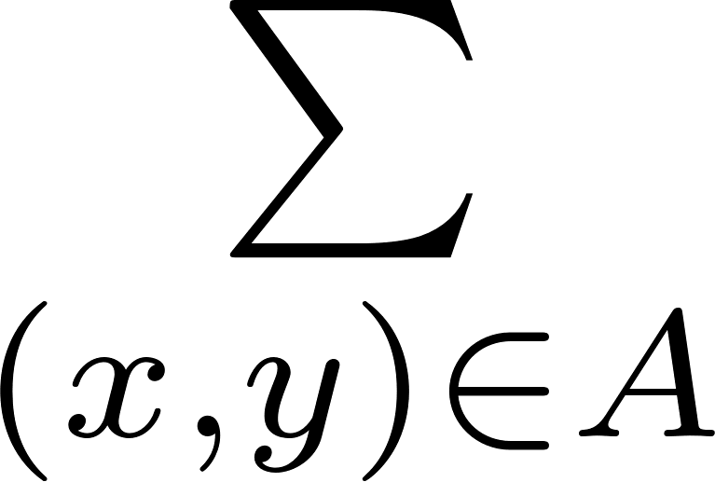
Multiple Random Variables
Joint PMF for Two Random Variables
If X and Y are two random variables in the same experiment
p_{X,Y} (x, y) = P ({X = x} ∩ {Y = y}) = P (X = x, Y = y)
if A = {(x, y)} is the set where x and y have some desired outcome,
P ((X, Y ) ∈ A) = p_{X,Y} (x, y) = P (A)
CS 355/555 Probability and Statistics for CS

Slide 14
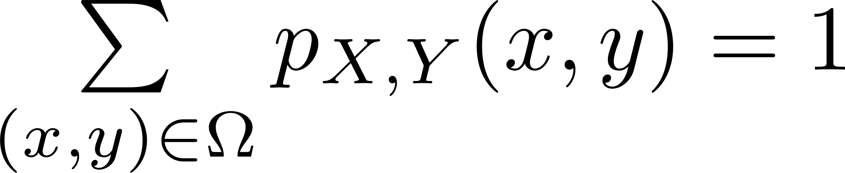
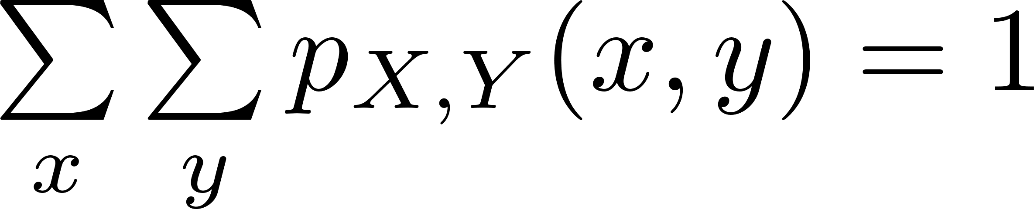
Multiple Random Variables
New Notation
If X and Y are two random variables in the same experiment
CS 355/555 Probability and Statistics for CS

Slide 15
Software Teams Example
 | CS | CF
NS | 5 12 | 1 12
NF | 1 4 | 1 4
CS 355/555 Probability and Statistics for CS

Slide 16
Software Teams Example
 | CS | CF
NS | 5 12 | 1 12 | 1 2
NF | 1 4 | 1 4 | 1 2
 | 2 3 | 1 3
CS 355/555 Probability and Statistics for CS

Slide 17


Marginal Probability Mass Function
Marginal Probability Mass Function
If X and Y are two rv s in the same experiment we can define the
Marginal Probability Mass Functions
p (x) = P
(x, y)
X
X,Y
p (y) = P
(x, y)
Y
X,Y
CS 355/555 Probability and Statistics for CS

Slide 18

Functions of Multiple Random Variables
Functions of Multiple Random Variables
If Z = g(X, Y )
p_{Z} (z) =
p_{X,Y} (x, y)
(x,y)|g(x,y)=z
CS 355/555 Probability and Statistics for CS
11/27 10:50

Slide 19
Functions of Multiple Random Variables
Functions of Multiple Random Variables
If Z = g(X, Y )
p_{Z} (z) =
p_{X,Y} (x, y)
(x,y)|g(x,y)=z
CS 355/555 Probability and Statistics for CS
11/27 10:50

Slide 20
Expectation with Multiple Random Variables
Expected Value of Multiple Random Variables
If Z = g(X, Y )
E[Z] = E[g(X, Y )] = g(x, y)p
X,Y
(x, y)
x,y
CS 355/555 Probability and Statistics for CS

Slide 21
Expectation with Multiple Random Variables
aX + bY + c
E([aX + bY + c] = aE[X] + bE[Y ] + c
CS 355/555 Probability and Statistics for CS

Slide 22
Example
What is the expected value of g(x, y) = x + y if X and Y are throws of a six sided die?
 | 1 | 2 | 3 | 4 | 5 | 6
1 | 2 | 3 | 4 | 5 | 6 | 7
2 | 3 | 4 | 5 | 6 | 7 | 8
3 | 4 | 5 | 6 | 7 | 8 | 9
4 | 5 | 6 | 7 | 8 | 9 | 10
5 | 6 | 7 | 8 | 9 | 10 | 11
6 | 7 | 8 | 9 | 10 | 11 | 12
P (any throw) = ¹ so add each column up and get 27, 33, 39, 45, 51,
36
57. Add these sums up and get 252.
²⁵² = 7, the expected value of a sum of two dice.
36
CS 355/555 Probability and Statistics for CS

Slide 23
PMF Example
Two random variables X and Y have the joint distribution function,
P_{X,Y} (0, 0) = 0.2, P_{X,Y} (0, 2) = 0.3, P_{X,Y} (1, 1) = 0.1,
P_{X,Y} (2, 0) = 0.3, P_{X,Y} (2, 2) = 0.1, and P_{X,Y} (x, y) = 0 for all other pairs (x, y).
First draw a picture/model.
 | 0 | 1 | 2
0 | .2 | 0 | .3 | .5
1 | 0 | .1 | 0 | .1
2 | .3 | 0 | .1 | .4
 | .5 | .1 | .4
CS 355/555 Probability and Statistics for CS

Slide 24
PMF Example
Are X and Y independent?
 | 0 | 1 | 2
0 | .2 | 0 | .3 | .5
1 | 0 | .1 | 0 | .1
2 | .3 | 0 | .1 | .4
 | .5 | .1 | .4
CS 355/555 Probability and Statistics for CS

Slide 25
PMF Example
Find the probability mass function of Z = X + Y .
 | Z
0 | .2
1 | 0
2 | .7
3 | .0
4 | .1
 | 0 | 1 | 2
0 | .2 | 0 | .3 | .5
1 | 0 | .1 | 0 | .1
2 | .3 | 0 | .1 | .4
 | 5 | .1 | .4
CS 355/555 Probability and Statistics for CS

Slide 26
PMF Example
Find the probability mass function of U = X − Y .
 | U
-2 | .3
-1 | 0
0 | .4
1 | 0
2 | .3
 | 0 | 1 | 2
0 | .2 | 0 | .3 | .5
1 | 0 | .1 | 0 | .1
2 | .3 | 0 | .1 | .4
 | 5 | .1 | .4
CS 355/555 Probability and Statistics for CS

Slide 27
PMF Example
Find the probability mass function of V = X × Y .
 | 0 | 1 | 2
0 | .2 | 0 | .3 | .5
1 | 0 | .1 | 0 | .1
2 | .3 | 0 | .1 | .4
 | 5 | .4 | .1
 | V
0 | .8
1 | .1
2 | 0
4 | .1
CS 355/555 Probability and Statistics for CS

Slide 28
Another PMF Example
Two random variables X and Y have the joint distribution function,
P_{X,Y} (0, 0) = 0.25, P_{X,Y} (0, 1) = 0.2, P_{X,Y} (0, 2) = 0.05, P_{X,Y} (1, 0) = 0.05,
P_{X,Y} (1, 1) = 0.04, P_{X,Y} (1, 2) = 0.01, P_{X,Y} (2, 0) = 0.2, P_{X,Y} (2, 1) = 0.16,
P_{X,Y} (2, 2) = 0.04.
CS 355/555 Probability and Statistics for CS
25/27 10:50

Slide 29
Another PMF Example
Two random variables X and Y have the joint distribution function,
P_{X,Y} (0, 0) = 0.25, P_{X,Y} (0, 1) = 0.2, P_{X,Y} (0, 2) = 0.05, P_{X,Y} (1, 0) = 0.05,
P_{X,Y} (1, 1) = 0.04, P_{X,Y} (1, 2) = 0.01, P_{X,Y} (2, 0) = 0.2, P_{X,Y} (2, 1) = 0.16,
P_{X,Y} (2, 2) = 0.04.
 | 0 | 1 | 2
0 | .25 | .20 | .05 | .50
1 | .05 | .04 | .01 | .10
2 | .20 | .16 | .04 | .40
 | .50 | .40 | .10
CS 355/555 Probability and Statistics for CS
25/27 10:50

Slide 30
More Examples
Model traffic accidents and as a function of time of day and day of week to estimate police investigation requirements.
CS 355/555 Probability and Statistics for CS
26/27 10:50

Slide 31
More Examples
Model traffic accidents and as a function of time of day and day of week to estimate police investigation requirements.
Model sports scores as a function of two teams playing.
CS 355/555 Probability and Statistics for CS
26/27 10:50

Slide 32
More Examples
Model traffic accidents and as a function of time of day and day of week to estimate police investigation requirements.
Model sports scores as a function of two teams playing.
Model number of air passengers as a function of origin, destination, and day of week.
CS 355/555 Probability and Statistics for CS
26/27 10:50

Slide 33
More Examples
Model traffic accidents and as a function of time of day and day of week to estimate police investigation requirements.
Model sports scores as a function of two teams playing.
Model number of air passengers as a function of origin, destination, and day of week.
Model used car sales as a function of manufacturer, model, and year.
CS 355/555 Probability and Statistics for CS
26/27 10:50

